Slide 1

Comparison of Structural and Metabolic Biomarkers of Neurodegeneration for Brain Age Prediction
The Link Between Brain Age and Alzheimer’s Disease Development Using Different Modalities
Doering, E., Antonopoulοs, G., Hönig, M., van Eimeren, T., Eickhoff, S., Patil, K., Drzezga, A.
Notes:
Welcome everyone to this talk. I am Elena Doering and today I would like to present you some of our work on how to best predict brain age in a way that is clinically useful to assess Alzheimer’s disease.

Slide 2

Nothing to disclose.
Notes:
First of all, I would like to thank the organizers of ADPD 2022 for giving me the opportunity to speak to you today and mention that I have nothing to disclose.

Slide 3




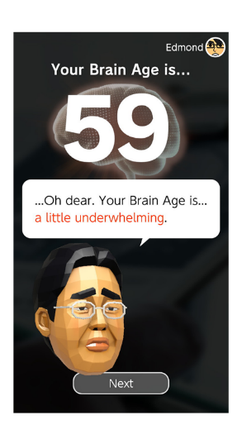
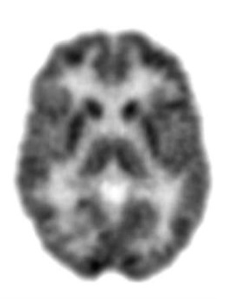
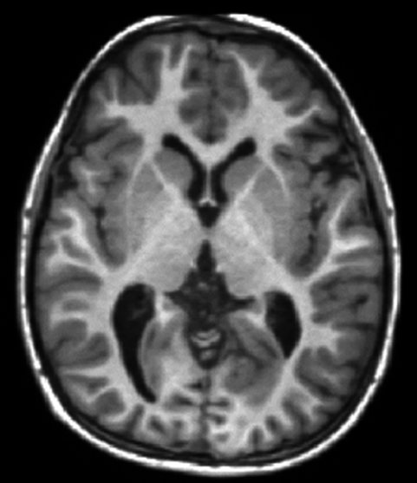
A biological definition of brain age
Notes:
When you ask someone in the general public “how could you define brain age?” they might say something like “well I’ve noticed it gets harder to concentrate or memorize as we get older so I would associate brain age with the loss of ability of such function.”
And of course that is one way to assess someone’s cognitive age, however in order to assess a person’s actual brain age and use it in clinical practice, we would need to use neuroimaging data. We call this “brain-predicted age”.

Slide 4




Brain-predicted age & BPAD
Brain-predicted age = machine learning algorithms learn to predict chronological age (CA) from brain scans
BPAD
= Difference between chronological age and brain-predicted age
- deviation from “normal” aging in a single number.
age = 75
CA = 63 BPA = 75
Chronological Age = 63 Brain age Prediction Brain-Predicted Age Difference = 12 years
Notes:
What is brain-predicted age and how is it assessed?
When machine learning algorithms learn to predict chronological age (CA) from brain scans, we refer to this as “brain age”.
So, for example, if you have a brain scan of a person aged 63 years, you could ask a machine learning model to predict the age. In this specific case, the model estimates a brain-predicted age of 75, thus yielding a brain-predicted age difference of 12 years. This brain-predicted age difference, the difference between brain-predicted age and chronological age, has various clinical functions.

Slide 5
Brain age can have various clinical functions
assess general brain health
detect disorders before symptom onset
support differential diagnosis
Notes:
For example, it can be used to summarize general brain health in one single number. Or it could be used to detect disorders before the emergence of symptoms. Or it could be used to support a differential diagnosis, for example you would expect the brain of a person with Alzheimer‘s disease to be older than that of a person with mild cognitive impairment.
Okay, but which neuroimaging data is actually used to predict brain age? So far, mostly volumetric data, that is, structural MRI scans, were used to predict brain age. However, cerebral glucose metabolism, that is, FDG-PET, may be equally useful in predicting brain age. It could be especially useful in very early stages of Alzheimer‘s disease, as we know that cell metabolism declines before regions degenerate.

Slide 6
Research aims
Compare precision of brain-predicted age using MRI and FDG-PET in cognitively normal individuals (CN).
Compare association of MRI and FDG-PET-BPAD with cognitive function, neuropathology and cognitive decline in CN and individuals with mild cognitive impairment (MCI).
PET-predicted age
MRI-predicted age
Chronological age
Chronological age
Notes:
This constitutes the basis for the current project.
Our first research aim was to compare the precision of brain-predicted age using MRI and FDG-PET in cognitively normal individuals.
The second aim was to compare associations of MRI and FDG-PET-BPAD with cognitive function, neuropathology and risk of cognitive decline in CN.

Slide 7

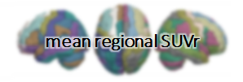


Compare precision of brain-predicted age in CN
379 FDG-PET and MRI scans from of CN from
frontal lobe left: 1.03 frontal lobe right: 1.25 … hippocampus left: 0.95 hippocampus right: 0.98
30% testing data (n = 123)
70 % training data (n = 256)
Trained model
+
External validation sample (n = 59)
+
MCI sample (n = 621)
Notes:
To answer the first research question, we pre-processed baseline FDG-PET and MRI scans of 379 cognitively normal individuals from the ADNI.
We necessitated FDG-PET and MRI scans to be from the same person and to have been assessed within one year from one another.
After spatial normalization, we extracted the mean signal of 216 cortical and subcortical regions, which served as input to the machine learning algorithms.
70% of the ADNI data were used as training data, while 30% were reserved for testing. We used an additional 59 scans from the OASIS database as an external validation set and we also applied the model to a sample of 621 MCI patients.

Slide 8
Five Models
Training Sample
One test prediction for each CN subject
Test Sample
Model 1: One test prediction for each subject in CN_validation and MCI sample
Notes:
In order to obtain one independent test prediction for each individual in the sample of cognitively normal individuals, we repeated the process of train-test splitting five times in the form of a stratified five-fold cross-validation.
Since neither the OASIS validation, nor the MCI sample were included in the train-test splitting, each of the five resulting models provided a prediction for these samples. Throughout this presentation, I will show you the predictions of the first model.

Slide 9
Participants
Table 1. Overview of samples
 | CN | CN_validation | MCI
n total | 379 | 59 | 621
Age [avg. years] | 74 | 72 (PET)/70 (MRI) | 73
Sex (F/M) | 196/183 | 35/24 | 264/355
MMSE [avg. score] | 29 | 29 | 28
Education [avg. years] | 16 | 16 | 16
Notes:
To give you a brief overview of our participants, they were all around the same age, on average between 70 and 74. More females were in the cognitively normal samples, whereas the MCI sample comprised more males.

Slide 10
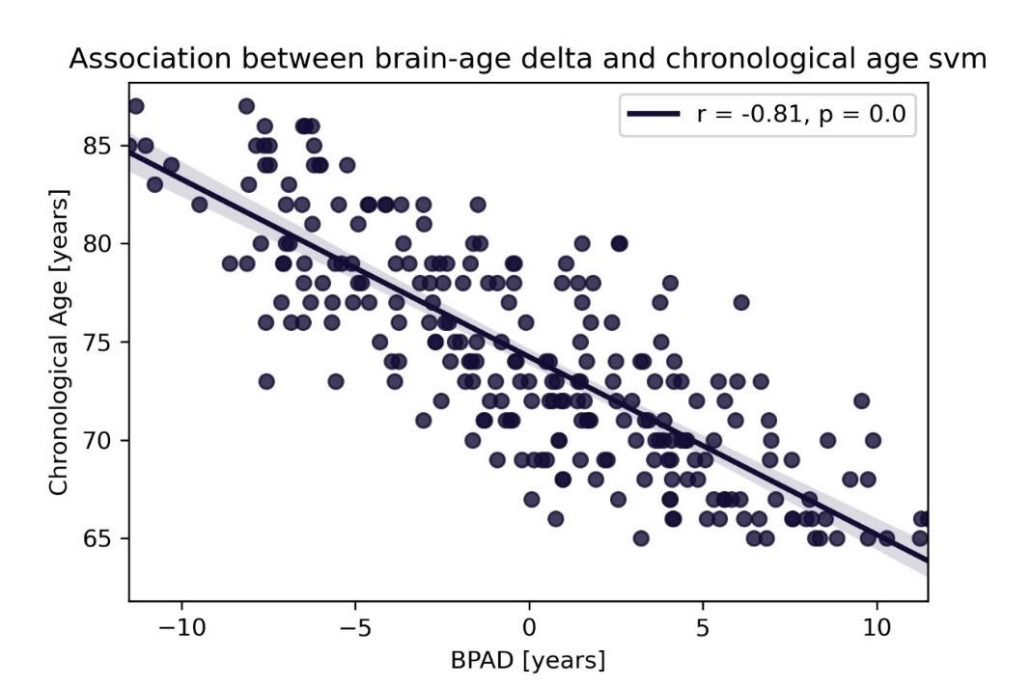
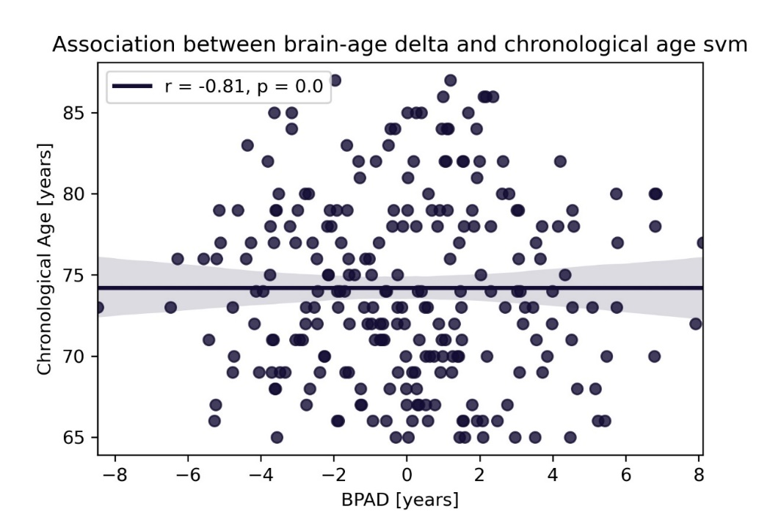
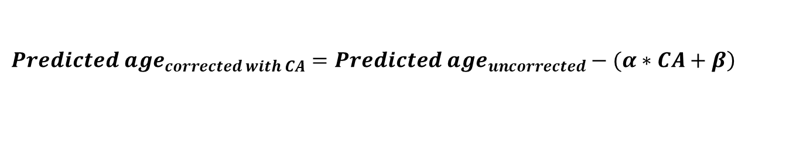
Bias Correction
$$\left.{Predicted age}_{corrected with CA}={Predicted age}_{uncorrected}−(α∗CA+β\right)$$
α = slope; β = intercept from linear model of CA X BPAD
PET
0, p = 1.0
Notes:
It is a very commonly observed phenomenon in brain age prediction that younger individuals are predicted to be older, while older individuals are predicted to be younger, as you can see in the left graph on this slide. This bias was corrected for by creating a linear model of chronological age and BPAD, and subsequently subtracting the inferred parameters from the predicted age.

Slide 11
Precision in brain age prediction is comparable across FDG and MRI
Table 2. Precision of predicting chronological age from FDG-PET and MRI scans. For CN_validation and MCI, results of the first model and metrics over all five models are shown.
 | CN |  | CN_validation |  | MCI
 | FDG | MRI | FDG | MRI | FDG | MRI
n total | 345⁺ | 345⁺ | 59⁺ | 59⁺ | 621 | 621
MAE | 1.99 | 1.89 | 1.83 | 2.42 | 1.94 | 2.66
Mean (SD) over 5 models | - | - | 2.04 (0.30) | 2.45 (0.19) | 2.17 (0.44) | 2.57 (0.11)
Mean difference | -0.10 | -0.05 | -0.80 | -0.80 | 0.78 | 1.15
Mean (SD) over 5 models | - | - | -0.66 (0.41) | -0.92 (0.16) | 0.67 (0.21) | 1.42 (0.16)
⁺After outlier exclusion using CN train set (IQR > 6)
Notes:
Here I present you results for the comparison between FDG-PET and MRI in brain age prediction.
As we can appreciate from the mean absolute error, or MAE, in the CN sample, the precision of brain age prediction was largely similar between FDG-PET and MRI. The age of cognitively normal individuals was on average underestimated by -0.1 and 0.05 years in the two modalities. This shows that our predictions were very precise.
In the CN_validation sample, FDG-PET did a slightly better job in predicting brain age, as both the mean absolute error and the mean difference were smaller in this modality.
In the MCI group, we found that individuals were estimated older than their actual chronological age by 0.67 and 1.42 years for FDG-PET and MRI, respectively. So we found a bigger difference between chronological and predicted age in the MCI population when using MRI.

Slide 12
Association of BPAD with Cognitive Function, Neuropathology, and Cognitive Decline
Cognitive Function (CF): ADNI-MEM, ADNI-EF
Neuropathology (NP): CSF Aβ, PET amyloid (global AV45), CSF Tau, CSF Ptau, PET tau (AV1451 meta-ROI)
Cognitive Decline (CD): Diagnosis after 24 months
Pearson/Spearman Correlations between BPAD and CF/NP
Partial correlations between BPAD and CF/NP controlling for age and sex
Logistic Regression to predict CD from BPAD, age and sex
Notes:
To assess the association of BPAD with cognitive function, we calculated correlations between BPAD and ADNI memory and executive function scores.
The association of BPAD and neuropathology was assessed through correlations between BPAD and CSF or PET amyloid or tau measures
Finally, we used logistic regression to predict individuals’ diagnosis in 24 months from BPAD, age and sex.

Slide 13
BPAD in CN
Notes:
Now I proceed to showing you results of associations of BPAD with cognitive function, neuropathology and cognitive decline in cognitively normal individuals.

Slide 14
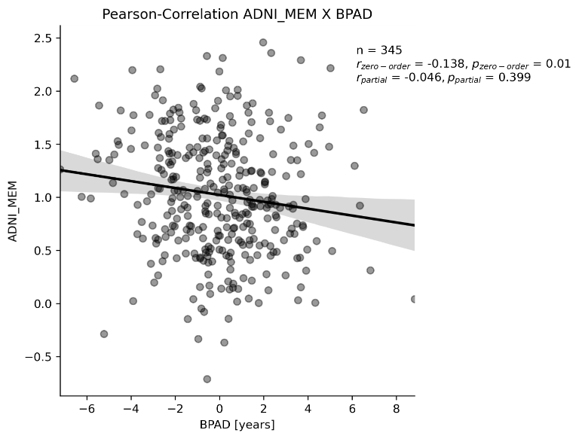
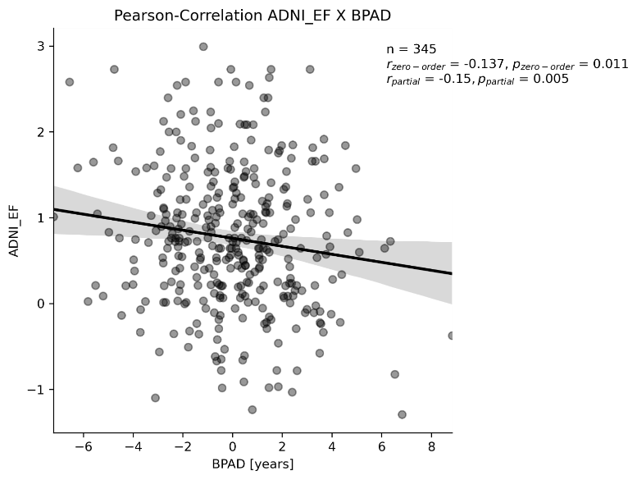
Higher MRI-BPAD is associated with worse cognitive performance in CN
Memory Executive Function
* Significant at p < 0.05, ** significant after Bonferroni correction
n = 345
r = -0.138**
Not correlated after correction for age and sex
n = 345
r = -0.137**
r_{partial} = -0.150**
Notes:
We found that higher MRI- but not FDG-BPAD was associated with worse cognitive performance in cognitively normal individuals. In these graphs here, we can see that both memory and executive function decline as BPAD rises, although only the decline in executive function withstands correction for age and sex in these correlations.

Slide 15
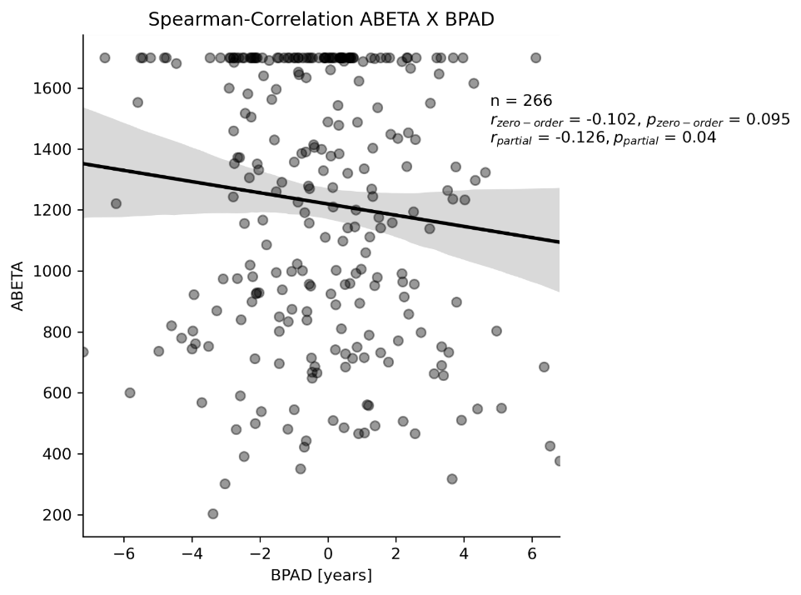
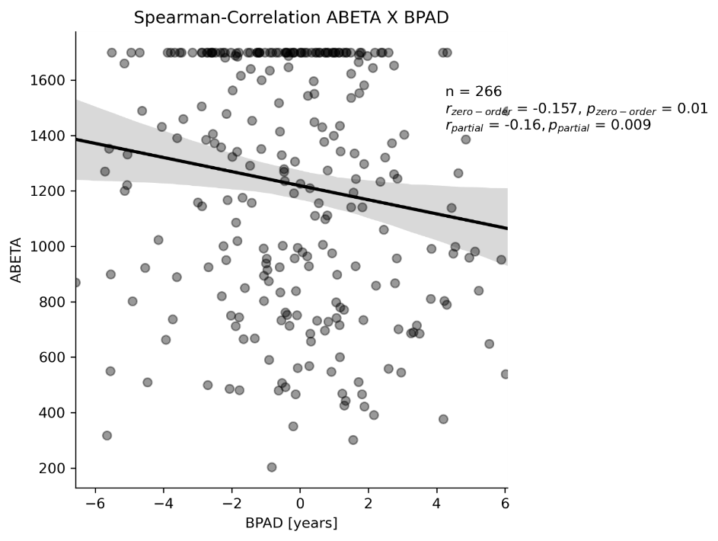
Higher BPAD (esp. FDG) is associated with lower CSF Aβ levels
CSF Aβ
* Significant at p < 0.05, ** significant after Bonferroni correction
CSF Aβ
n = 266
Not significant without correction for age and sex
ρ_{partial} = 0.126*
n = 266
ρ = -0.157*
ρ_{partial} = 0.160**
Notes:
In terms of neuropathology in cognitively normal individuals, however, we found more significant associations between FDG-PET and CSF amyloid beta. MRI BPAD correlations did not survive Bonferroni correction.

Slide 16
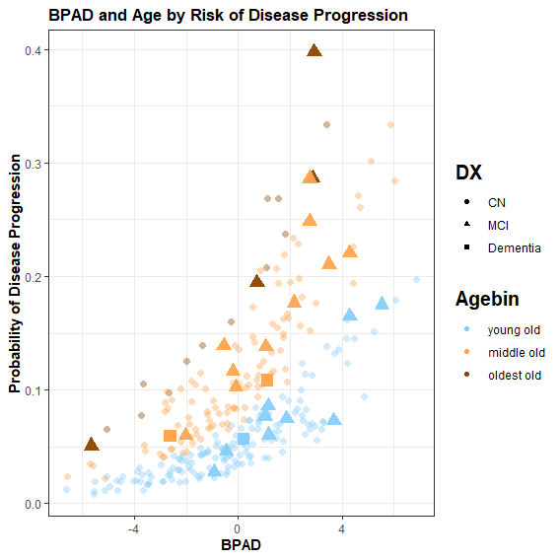
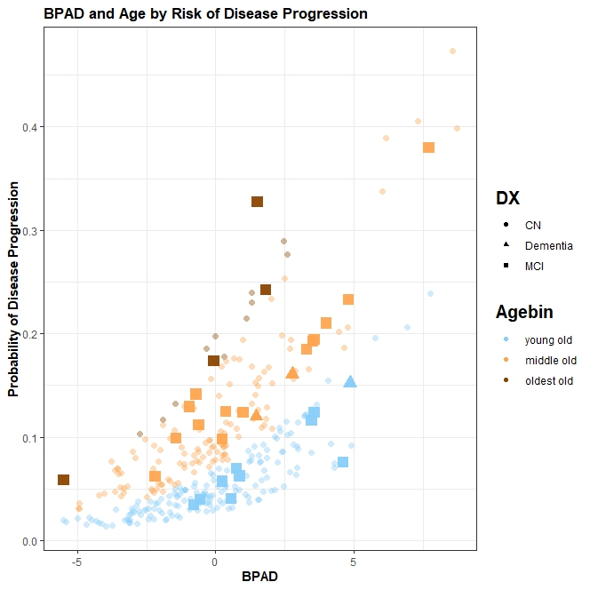
FDG-BPAD predicts conversion to MCI/Alzheimer’s disease in CN
27% increased odds to develop (mild) cognitive impairment within two years per one year BPAD (95%CI [7%, 51%])
age: OR = 10% (95%CI [3%, 19%])**, sex not significant in logistic regression
negative BPAD
Total: 153
Converters: 8 (5%)
positive BPAD
Total: 142
Converters: 18 (13%)
27%
**
.
Diagnosis after 24 months
CN (n=305)
MCI (n=23)
AD (n=3)
Age Category
Young old (<75 y.)
Middle old (75 – 84 y.)
Oldest old (> 85 y.)
* Significant at p < 0.05, ** p < 0.01, *** p < 0.001
0
Notes:
Finally, a diagnosis of MCI or Alzheimers disease two years after the scans were taken was significantly predicted from FDG BPAD. We found that the odds of someone converting to an MCI/AD diagnosis within two years are increased by 27% for every additional year in BPAD. The graph on the right shows individuals’ BPAD plotted against der predicted probability of disease progression. We see that both increasing BPAD, the position on the x-axis, and increasing age, the colors, contribute to a higher probability of conversion.
MRI BPAD did not significantly predict a person’s diagnosis in two years.

Slide 17
BPAD in MCI
Notes:
Now I proceed to showing you results of associations of BPAD with cognitive function, neuropathology and cognitive decline in patients diagnosed with mild cognitive impairment.

Slide 18
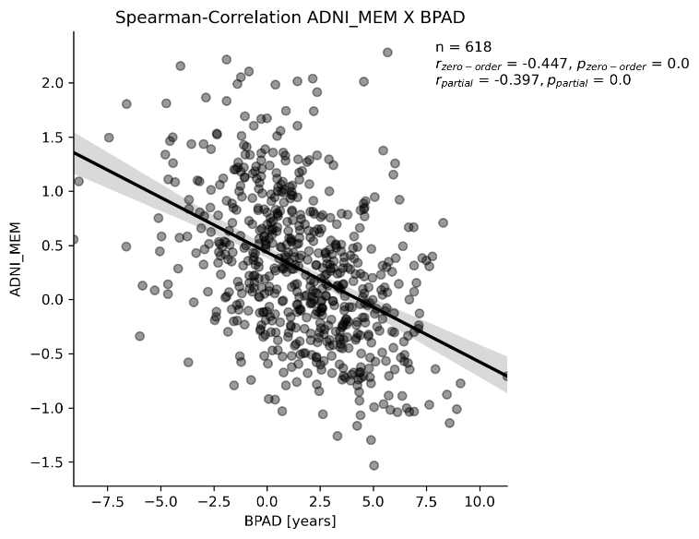
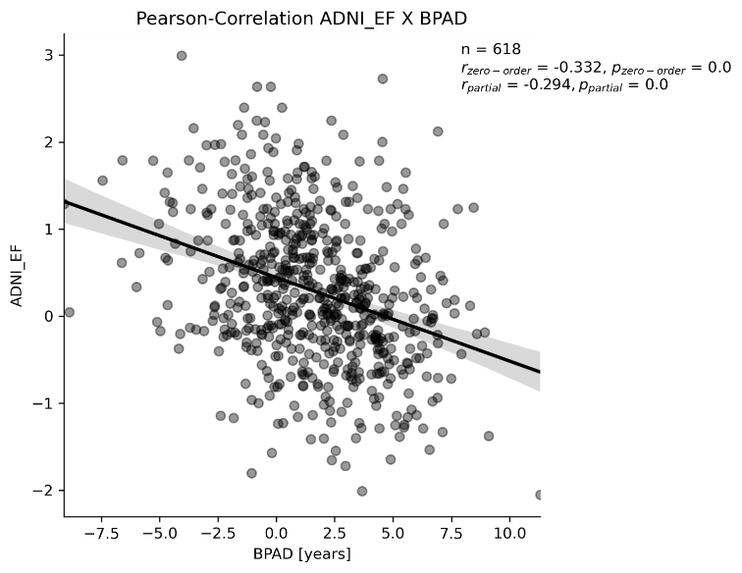
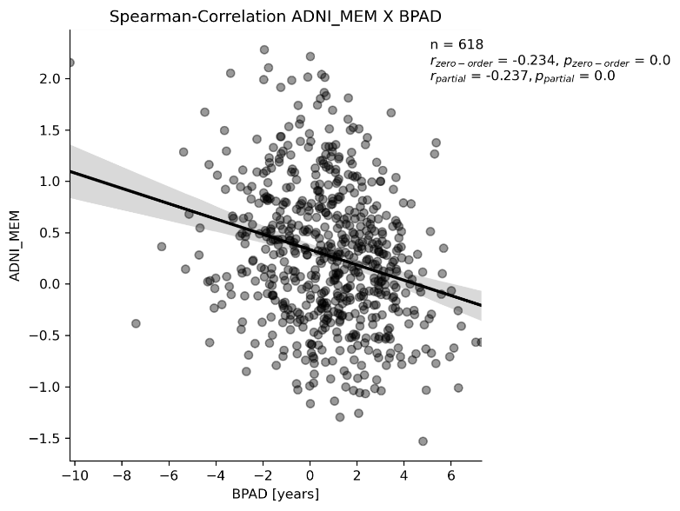
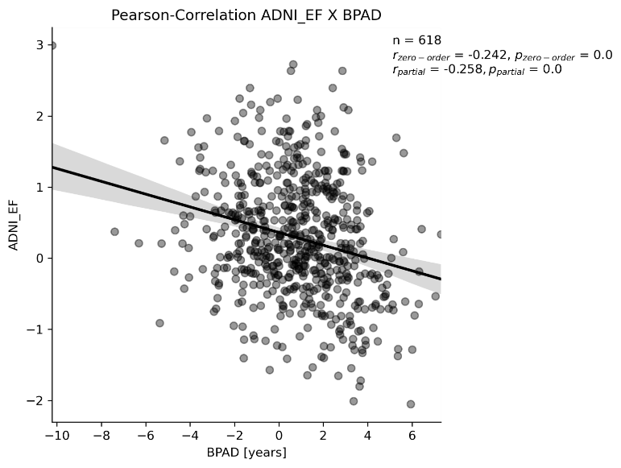
Higher BPAD (esp. MRI) is associated with worse cognitive performance in MCI
Memory Executive Function
* Significant at p < 0.05, ** significant after Bonferroni correction
n = 618
r = -0.332**
r_{partial} = -0.294**
n = 618
ρ = -0.234**
ρ_{partial} = -0.237**
n = 618
r = -0.242**
r_{partial} = -0.258**
n = 618
ρ = -0.447**
ρ_{partial} = -0.397**
n = 618
r = -0.332**
r_{partial} = -0.294**
Memory Executive Function
Notes:
Higher BPAD in both modalities is associated with worse memory and executive function scores. All correlations were significant with and without correction for age and sex and withstood Bonferroni correction. A Fisher transformation of the correlation coefficients revealed that memory decline was associated more strongly with MRI-BPAD as compred to FDG-BPAD, while no significant difference was found for the decline in executive function.

Slide 19
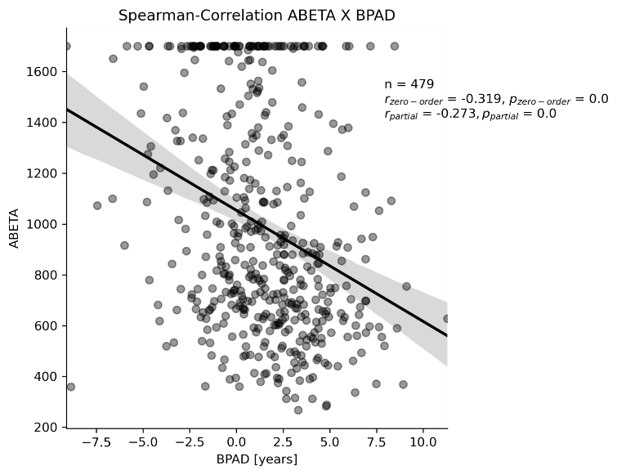
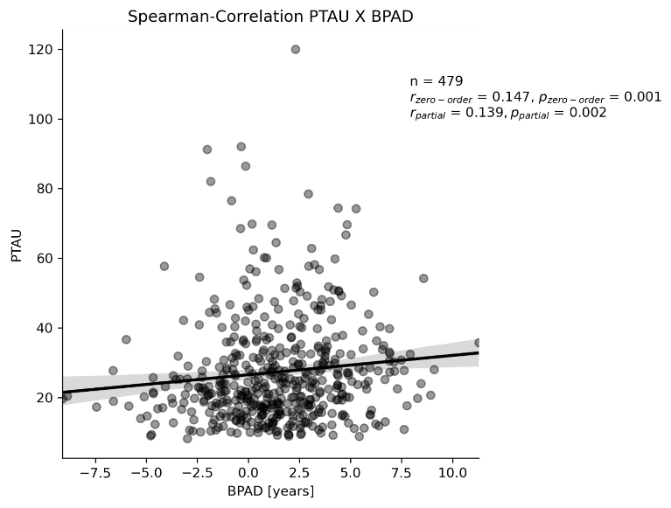
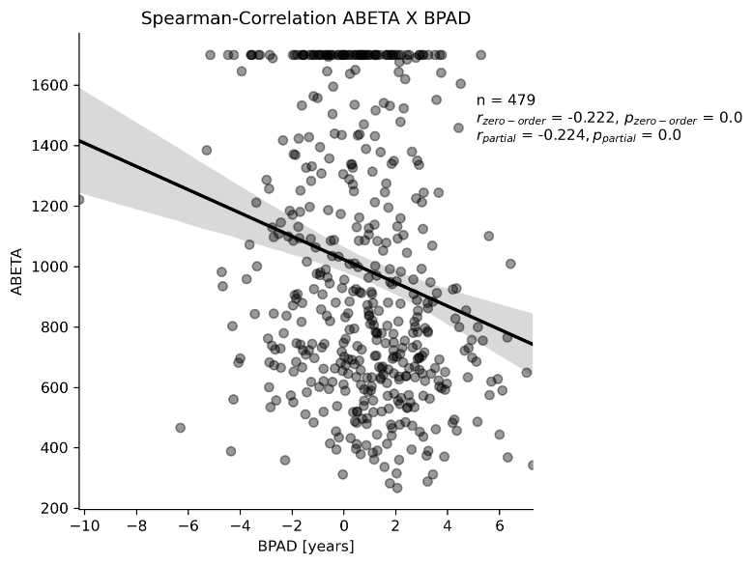
Higher BPAD (esp. MRI) is associated with more neuropathology in MCI
Amyloid PTau
* Significant at p < 0.05, ** significant after Bonferroni correction
n = 479
ρ = -0.222**
ρ_{partial} = -0.224**
n = 479
ρ = -0.319**
ρ_{partial} = -0.273**
n = 479
ρ = 0.147**
ρ_{partial} = 0.139**
Amyloid Tau
Notes:
Especially MRI-BPAD was also associated with enhanced neuropathology in terms of CSF and PET amyloid, as well as CSF tau and phosphorylated tau. FDG-PET was associated comparably strong with amyloid, however there were no correlations with measures of tau in patients with mild cognitive impairment.

Slide 20
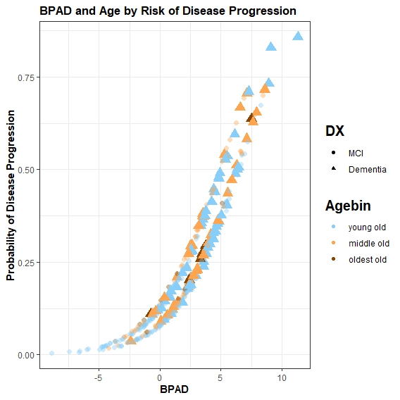
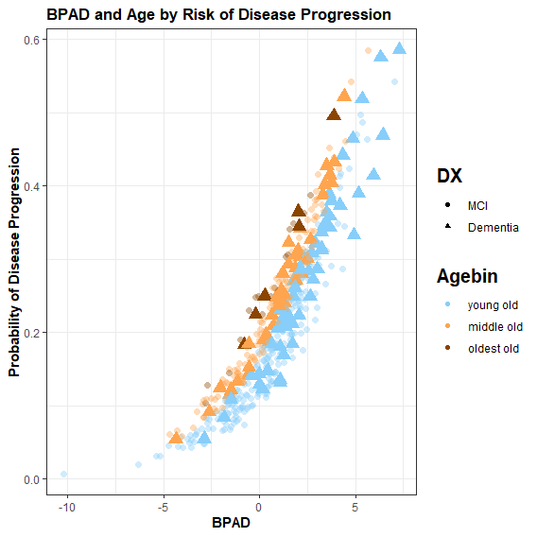
Higher BPAD (esp. MRI) predicts conversion to Alzheimer’s disease in MCI
.
MCI (n=362) AD (n=100)
Diagnosis after 24 months
Age Category
<75 y. 75 – 84 y. > 85 y.
negative BPAD
Total: 131
Converters: 5 (4%)
negative BPAD
Total: 159
Converters: 16 (10%)
46%
***
36%
***
increased odds per 1 year BPAD to develop AD within 2 years
increased odds per 1 year BPAD to develop AD within 2 years
positive BPAD
Total: 331
Converters: 95 (29%)
positive BPAD
Total: 303
Converters: 84 (28%)
0
* Significant at p < 0.05, ** p < 0.01, *** p < 0.001
0
Notes:
Finally, a diagnosis of Alzheimers disease two years after the scans were taken was significantly predicted from BPAD in both modalities. From these two graphs showing the probability of progression to Alzheimer’s disease by BPAD and age, we can appreciate that especially in MRI, the fitted logistic regression makes use of BPAD to predict the development of Alzheimer’s disease. If we compare the numbers of individuals converting to Alzheimer’s disease in negative and positive BPAD, we find that only a minority of individuals with a negative MRI-BPAD convert to AD, while a considerable 29% with a positive BPAD will convert to AD. This distinction appears less clear on the right-hand side, where results for FDG-PET are portrayed. For both modalities, the odds of developing Alzheimer’s disease within the next two years increase by a considerable percentage per one year BPAD, almost 50% for MRI-BPAD!

Slide 21
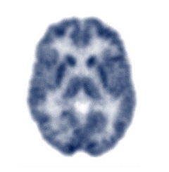
And the winner is…
Brain age can be predicted comparably well from FDG-PET or MRI, but…
Cognitive Performance
AD Neuropathology
Disease Progression
CN
FDG-PET-predicted age better captures early disease-related neuropathology and risk.
Onset of tau-related neurodegeneration and of objective cognitive decline is more strongly associated with signals of increasing brain age on MRI.
MCI
Notes:
So now let’s wrap it up.
We found that brain age can be predicted comparably well from FDG-PET or MRI, however
READ

Slide 22

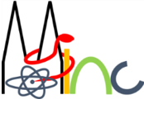


















Thank you for your attention!
Dr. Gérard Bischof
(PostDoc)
Dr. Kathrin Giehl
(Study coordinator)
Dr. Merle Hönig
(PostDoc)
MultiModal
Prof. Dr. Thilo van Eimeren
Head of MMNI Group,
Dpt. of Neurology & Nuclear Medicine
Dr. Hendrik Theis
(MD)
NeuroImaging
Elena Doering
(PhD student)
Prof. Dr. Simon Eickhoff
Director of the Institute Brain and Behaviour (INM-7)
Dr. Kaustubh Patil
Leader of the research group “Applied Machine Learning”
Group.de
Verena Dzialas
(PhD student)
Julia Pfeil
(PhD student)
Prof. Dr. Alexander Drzezga
Head of Dpt. Nuclear Medicine
& INM-II, Research Center Jülich
Magdalena Banwinkler
(PhD student)
Dr. Georgios Antonopoulos
(PostDoc)
Adrian Asendorf
(PhD student)
Contact info: elena.doering@uk-koeln.de

